Slide 1
Ethereum 101

Slide 2
Introduction
Ethereum was conceptualized by Vitalik Buterin in November 2013.
The key idea proposed was the development of a Turing-complete language
Allows the development of arbitrary programs (smart contracts) for blockchain and decentralized applications.
This is in contrast to bitcoin,
where the scripting language is very limited and allows basic and necessary operations only.

Slide 3
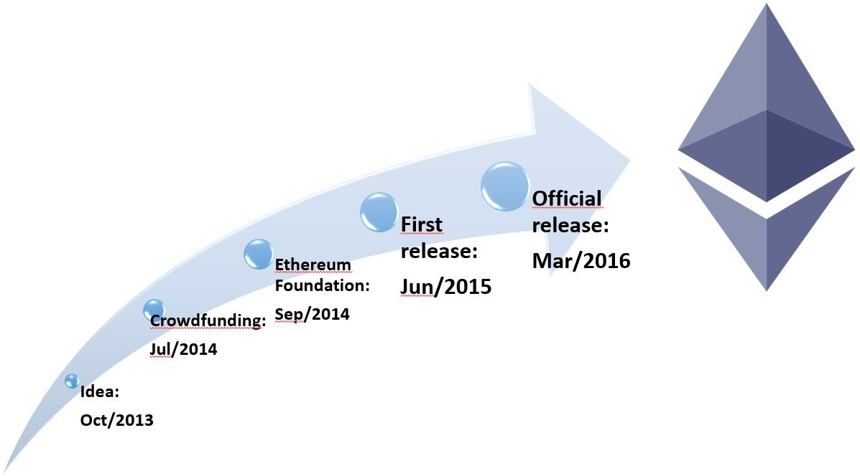

History of Ethereum - Timeline

Slide 4
Ethereum clients and releases
Various Ethereum clients have been developed using different languages
Most popular are go-Ethereum and parity.
go-Ethereum was developed using Golang,
parity was built using Rust.
go-Ethereum client known as geth is sufficient for all purposes.
Mist is a user-friendly Graphical User Interface (GUI) wallet that runs geth in the background to sync with the network.

Slide 5
Ethereum clients and releases
The first release of Ethereum was known as Frontier
current release of Ethereum is called St. Petersburgh release.
The next release is named Istanbul .
The final release is named serenity, which is envisaged to have a Proof of Stake algorithm (Casper) implemented with it.
Other areas of research targeted with serenity include
Scalability
Privacy
Ethereum virtual machine (EVM) upgrade.

Slide 6
Ethereum clients and releases
Ethereum ecosystem will undergo constant improvement and development
serenity should not really be considered a final version but a major milestone in a long journey of continuous improvement.
Further releases are envisaged but have not been named yet.
The vision of web 3.0 has already been proposed and is being discussed in the community.

Slide 7
Ethereum clients and releases
Web 3.0 is a concept that basically proposes a semantic and intelligent web as an evolution of the existing web 2.0 technology.
Ecosystem where people, applications, data, and web are all connected together and are able to interact with each other in an intelligent fashion.
With the advent of the blockchain technology, an idea of decentralized web has also emerged
All major services, such as DNS, search engines, and identity on the Internet will be decentralized in web 3.0.
Ethereum is being envisaged as a platform that can help realize this vision.

Slide 8
The Ethereum stack
The Ethereum stack consists of various components.
At the core, there is the Ethereum blockchain running on the P2P Ethereum network.
Secondly, there's an Ethereum client (usually geth) that runs on the nodes and connects to the peer-to-peer Ethereum network
blockchain is downloaded and stored locally.
It provides various functions, such as mining and account management.
The local copy of the blockchain is synchronized regularly with the network.
Another component is the web3.js library that allows interaction with geth via the Remote Procedure Call (RPC) interface.

Slide 10
Ethereum blockchain
Ethereum, can be visualized as a transaction-based state machine.
Genesis state is transformed into a final state by executing transactions incrementally.
Final transformation is then accepted as the absolute undisputed version of the state.

Slide 11
Transfer of 2 Ether from Address 4718bf7a to Address 741f7a2 is initiated

Slide 12
Currency (ETH and ETC)
As an incentive to the miners, Ethereum also rewards its native currency called Ether, abbreviated as ETH.
After the DAO hack a hard fork was proposed in order to mitigate the issue;
There are now two Ethereum blockchains:
Ethereum classic and its currency is represented by ETC
Hard-forked version is ETH, which continues to grow
ETC, has a dedicated community that is further developing ETC, which is the nonforked original version of Ethereum.

Slide 13
Forks
With the release of homestead, due to major protocol upgrades, it resulted in a hard fork.
The protocol was upgraded at block number 1,150,000,
Resulting in the migration from the first version of Ethereum known as Frontier to the second version of Ethereum called homestead.

Slide 14
Forks
A recent unintentional fork that occurred on November 24, 2016, at 14:12:07 UTC was due to a bug in the geth client's journaling mechanism.
Network fork occurred at block number 2,686,351.
This bug resulted in geth failing to revert empty account deletions in the case of the empty out-of-gas exception.
This means that from block number 2686351, the Ethereum blockchain is split into two, one running with parity clients and the other with geth.
This issue was resolved with the release of geth version 1.5.3.

Slide 15
Gas
Another key concept in Ethereum is that of gas.
All transactions on the Ethereum blockchain are required to cover the cost of computation they are performing.
Cost is covered by something called gas or crypto fuel,
Gas as execution fee is paid upfront by the transaction originators.
fuel is consumed with each operation.

Slide 16
Gas
Each operation has a predefined amount of gas associated with it.
Each transaction specifies the amount of gas it is willing to consume for its execution.
If it runs out of gas before the execution is completed, any operation performed by the transaction up to that point is rolled back.
If the transaction is successfully executed, then any remaining gas is refunded to the transaction originator.

Slide 17
The consensus mechanism
Consensus mechanism in Ethereum is based on the GHOST protocol originally proposed by Zohar and Sompolinsky in December 2013
Ethereum uses a simpler version of GHOST protocol,
where the chain that has most computational effort spent on it in order to build it is identified as the definite version.
Another way is to find the longest chain, as the longest chain must have been built by consuming adequate mining effort.

Slide 18
The consensus mechanism
Greedy Heaviest Observed Subtree (GHOST) was first introduced as a mechanism
to alleviate the issues arising out of fast block generation times that led to stale or orphan blocks.
Stale blocks :
Blocks that were propagated to the network and verified by some nodes as being correct but eventually being cast off as a longer chain achieved dominance, or Forking
Orphan, or stale block, is created when two nodes find a block at the same time. Both say we’ve found the solution to this block and send off their block to be verified and included in others block chains.
In GHOST, stale blocks are added in calculations to figure out the longest and heaviest chain of blocks.
Stale blocks are called Uncles or Ommers in Ethereum.

Slide 19
The consensus mechanism
GHOST includes stale blocks – or Uncles
These are included in the calculation of which chain is longest or has the highest cumulative difficulty.
Centralisation is solved by giving block rewards to stales of 87.5%
Nephew (child of the Uncle block) also receives a reward of 12.5% of the block reward.

Slide 20
The consensus mechanism
The Ethereum version of Ghost only goes down seven levels – or back seven levels in the height of the block chain.
A block must specify its parents and its number of Uncles.
An Uncle included in a block must be a direct child of the new block and less than seven blocks below it in terms of height
It cannot be the direct ancestor of the block being formed.
An Uncle must have a valid block header.
An Uncle must be different from all other Uncles in previous blocks and the block being formed.
For every Uncle included in the block the miner gets an additional 3.125% of a standard block reward.
Miner of of the Uncle receives 93.75% of a standard block reward.

Slide 21
Blocks with less difficulty add less work Two blocks in the same difficulty period always add the same amount of work to the chain

Slide 22
The world state
The world state in Ethereum represents the global state of the Ethereum blockchain.
It is basically a mapping between Ethereum addresses and account states.
Addresses are 20 bytes long.
This mapping is a data structure that is serialized using Recursive Length Prefix (RLP).
RLP is a specially developed encoding scheme that is used in Ethereum to serialize binary data for storage or transmission over the network and also to save the state in a Patricia tree.
The RLP function takes an item as an input, which can be a string or a list of items
produces raw bytes that are suitable for storage and transmission over the network.
RLP does not encode data; instead, its main purpose is to encode structures.

Slide 23
Account state
Account state consists of four fields:
nonce
balance
storageroot
codehash

Slide 24
The account state
Nonce
This is a value that is incremented every time a transaction is sent from the address.
In case of contract accounts, it represents the number of contracts created by the account.
Contract accounts are one of the two types of accounts that exist in Ethereum
Balance
Represents the number of Weis which is the smallest unit of the currency (Ether) in Ethereum held by the address.

Slide 25
The account state
Storageroot
This field represents the root node of a Merkle Patricia tree that encodes the storage contents of the account.
Codehash
This is an immutable field that contains the hash of the smart contract code that is associated with the account.
In the case of normal accounts, this field contains the Keccak 256-bit hash of an empty string.
This code is invoked via a message call.

Slide 26
world state and its relationship with accounts trie, accounts, and block header

Slide 27
world state and its relationship with accounts trie, accounts, and block header
It shows the account data structure in the middle of the diagram,
which contains a storage root hash derived from the root node of the account storage trie shown on the left.
The account data structure is then used in the world state trie,
which is a mapping between addresses and account states.
Finally, the root node of the world state trie is hashed using the Keccak 256-bit algorithm and made part of the block header data structure,
which is shown on the right-hand side of the diagram as state root hash.

Slide 28
World state and its relationship with accounts trie, accounts, and block header
Accounts trie is basically a Merkle Patricia tree used to encode the storage contents of an account.
The contents are stored as a mapping between keccak 256-bit hashes of 256-bit integer keys to the RLP-encoded 256-bit integer values.

Slide 29
Transactions
Transaction in Ethereum is a digitally signed data packet using a private key that contains the instructions that
when completed, either result in a message call or contract creation.
Transactions can be divided into two types based on the output they produce:
Message call transactions:
This transaction simply produces a message call that is used to pass messages from one account to another.
Contract creation transactions:
Transactions result in the creation of a new contract.
When this transaction is executed successfully, it creates an account with the associated code.

Slide 30
Transactions
Both transactions are composed of a number of common fields
Nonce
Nonce is a number that is incremented by one every time a transaction is sent by the sender.
It must be equal to the number of transactions sent and is used as a unique identifier for the transaction.
A nonce value can only be used once.
gasPrice
gasPrice field represents the amount of Wei required in order to execute the transaction.

Slide 31
gasLimit
gasLimit field contains the value that represents the maximum amount of gas that can be consumed in order to execute the transaction.
This is the amount of fee in Ether that a user is willing to pay for computation
To
To field is a value that represents the address of the recipient of the transaction.
Value
Value represents the total number of Wei to be transferred to the recipient;
In the case of a contract account, this represents the balance that the contract will hold.

Slide 32
Signature
Signature is composed of three fields, namely v, r, and s.
These values represent the digital signature (R, S) and some information that can be used to recover the public key (V).
Also of the transaction from which the sender of the transaction can also be determined
Signature is based on ECDSA scheme and makes use of the SECP256k1 curve.

Slide 33
Init
Init field is used only in transactions that are intended to create contracts.
Byte array of unlimited length that specifies the EVM code to be used in the account initialization process.
Code contained in this field is executed only once, when the account is created for the first time, and gets destroyed immediately after that.
Init also returns another code section called body, which persists and runs in response to message calls that the contract account may receive.
These message calls may be sent via a transaction or an internal code execution.

Slide 34
Data
If the transaction is a message call, then the data field is used instead of init, which represents the input data of the message call.
It is also unlimited in size and is organized as a byte array.

Slide 36
Transactions
Transaction is a tuple of the fields, which is then included in a transaction trie (a modified Merkle-Patricia tree)
Finally, the root node of transaction trie is hashed using a Keccak 256-bit algorithm and is included in the block header along with a list of transactions in the block.
Transactions can be found in either transaction pools or blocks.
When a mining node starts its operation of verifying blocks, it starts with the highest paying transactions in the transaction pool and executes them one by one.
When the gas limit is reached or no more transactions are left to be processed in the transaction pool, the mining starts.

Slide 37
Transactions
In Mining process, the block is repeatedly hashed until a valid nonce is found that, once hashed with the block, results in a value less than the difficulty target.
Once the block is successfully mined, it will be broadcasted immediately to the network, claiming success, and will be verified and accepted by the network.
Similar to Bitcoin's mining process
The only difference is that Ethereum's Proof of Work algorithm is ASIC-resistant, known as Ethash, where finding a nonce requires large memory.

Slide 38
Contract creation transaction
There are a few essential parameters that are required when creating an account
Parameters are listed as follows:
Sender
Original transactor
Available gas
Gas price
Endowment, which is the amount of ether allocated initially
A byte array of arbitrary length
Initialization EVM code
Current depth of the message call/contract-creation stack
Current depth means the number of items that are already there in the stack

Slide 39
Contract creation transaction
Addresses generated as a result of contract creation transaction are 160-bit in length.
They are the rightmost 160-bits of the Keccak hash of the RLP encoding of the structure containing only the sender and the nonce.
Initially, the nonce in the account is set to zero.
The balance of the account is set to the value passed to the contract.
Storage is also set to empty.
Code hash is Keccak 256-bit hash of the empty string.

Slide 40
Contract creation transaction
The account is initialized when the EVM code (Initialization EVM code) is executed.
In the case of any exception during code execution, such as not having enough gas, the state does not change.
If the execution is successful, then the account is created after the payment of appropriate gas costs.
The version of Ethereum (homestead) specifies that the result of contract transaction is either a new contract with its balance, or no new contract is created with no transfer of value.

Slide 41
Message call transaction
Message call requires several parameters for execution, which are listed as follows:
Sender
The transaction originator
Recipient
The account whose code is to be executed
Available gas
Value
Gas price
Arbitrary length byte array
Input data of the call
Current depth of the message call/contract creation stack

Slide 42
Message call transaction
Message calls result in state transition.
Message calls also produce output data, which is not used if transactions are executed.
In cases where message calls are triggered by VM code, the output produced by the transaction execution is used.

Slide 43
Two types of transaction

Slide 44
Elements of the Ethereum blockchain - Ethereum virtual machine (EVM)
EVM is a simple stack-based execution machine that runs bytecode instructions in order to transform the system state from one state to another.
Word size of the virtual machine is set to 256-bit.
Stack size is limited to 1024 elements and is based on the LIFO (Last in First Out) queue.
EVM is a Turing-complete machine but is limited by the amount of gas that is required to run any instruction.
This means that infinite loops that can result in denial of service attacks are not possible due to gas requirements.
EVM also supports exception handling in case exceptions occur, such as not having enough gas or invalid instructions,
in which case the machine would immediately halt and return the error to the executing agent.

Slide 45
Ethereum virtual machine (EVM)
EVM is a fully isolated and sandboxed runtime environment.
The code that runs on the EVM does not have access to any external resources, such as a network or file system.
EVM is a stack-based architecture.
EVM is big-endian by design and it uses 256-bit wide words.
Word size allows for Keccak 256-bit hash and elliptic curve cryptography computations.
There are two types of storage available to contracts and EVM.
The first one is called memory, which is a byte array.
When a contract finishes the code execution, the memory is cleared. It is akin to the concept of RAM.
The other type, called storage, is permanently stored on the blockchain. It is a key value store.

Slide 46
Ethereum virtual machine (EVM)
Memory is unlimited but constrained by gas fee requirements.
Storage associated with the virtual machine is a word array that is nonvolatile and is maintained as part of the system state.
Keys and value are 32 bytes in size and storage.
Program code is stored in a virtual read-only memory (virtual ROM) that is accessible using the CODECOPY instruction.
CODECOPY instruction is used to copy the program code into the main memory.
Initially, all storage and memory is set to zero in the EVM.

Slide 48
Ethereum virtual machine (EVM)
Diagram shows the design of the EVM where the virtual ROM stores the program code that is copied into main memory using CODECOPY.
Main memory is then read by the EVM by referring to the program counter and executes instructions step by step.
Program counter and EVM stack are updated accordingly with each instruction execution.
EVM optimization is an active area of research
Recent research has suggested that EVM can be optimized and tuned to a very fine degree in order to achieve high performance.

Slide 49
Execution environment
There are some key elements that are required by the execution environment in order to execute the code.
The key parameters are provided by the execution agent
Address of the account that owns the executing code.
Address of the sender of the transaction and the originating address of this execution.
Gas price in the transaction that initiated the execution.
Input data or transaction data depending on the type of executing agent. This is a byte array;
In the case of a message call, if the execution agent is a transaction, then the transaction data is included as input data.

Slide 50
Execution environment - key parameters
Address of the account that initiated the code execution or transaction sender.
This is the address of the sender in case the code execution is initiated by a transaction; otherwise, it's the address of the account.
value or transaction value.
This is the amount in Wei. If the execution agent is a transaction, then it is the transaction value.
The code to be executed presented as a byte array that the iterator function picks up in each execution cycle.
Block header of the current block
The number of message calls or contract creation transactions currently in execution.
In other words, this is the number of CALLs or CREATEs currently in execution.

Slide 52
Execution environment
In addition to the nine fields, system state and the remaining gas are also provided to the execution environment.
The execution results in producing
resulting state
gas remaining after the execution
self-destruct or suicide set
log series
any gas refunds.

Slide 53
Gas
Halting problem (infinite loop) – reason for Gas
Problem: Cannot tell whether or not a program will run infinitely from compiled code
Solution: charge fee per computational step to limit infinite loops and stop flawed code from executing
Every transaction needs to specify an estimate of the amount of gas it will spend
Essentially a measure of how much one is willing to spend on a transaction, even if buggy

Slide 54
Gas Cost
Gas Price: current market price of a unit of Gas (in Wei)
Check gas price here: https://ethgasstation.info/
Is always set before a transaction by user
Gas Limit: maximum amount of Gas user is willing to spend
Helps to regulate load on network
Gas Cost (used when sending transactions) is calculated by gasLimit*gasPrice.
All blocks have a Gas Limit (maximum Gas each block can use)

Slide 55
Code Execution
Every node contains a virtual machine (similar to Java)
Called the Ethereum Virtual Machine (EVM)
Compiles code from high-level language to bytecode
Executes smart contract code and broadcasts state
Every full-node on the blockchain processes every transaction and stores the entire state

Slide 56
Machine state
Machine state is also maintained internally by the EVM.
Machine state is updated after each execution cycle of EVM.
An iterator function runs in the virtual machine, which outputs the results of a single cycle of the state machine.
Machine state is a tuple that consist of the following elements:
Available gas
The program counter, which is a positive integer up to 256
Memory contents
Active number of words in memory
Contents of the stack

Slide 57
Machine state
The EVM is designed to handle exceptions and will halt (stop execution) in case any of the following exceptions occur:
Not having enough gas required for execution
Invalid instructions
Insufficient stack items
Invalid destination of jump op codes
Invalid stack size (greater than 1024)

Slide 58
The iterator function
The iterator function performs various important functions that are used to set the next state of the machine and eventually the world state.
These functions include the following:
It fetches the next instruction from a byte array where the machine code is stored in the execution environment.
It adds/removes (PUSH/POP) items from the stack accordingly.
Gas is reduced according to the gas cost of the instructions/Opcodes.
It increments the program counter (PC).

Slide 59
Machine state can be viewed as a tuple

Slide 60
Virtual machine is also able to halt in normal conditions if STOP or SUICIDE or RETURN Opcodes are encountered during the execution cycle.
Code written in a high-level language such as serpent, LLL, or Solidity is converted into the byte code that EVM understands in order for it to be executed by the EVM.
Solidity is the high-level language that has been developed for Ethereum with JavaScript such as syntax to write code for smart contracts.
Once the code is written, it is compiled into byte code that's understandable by the EVM using the Solidity compiler called solc.
LLL (Lisp-like Low-level language) is another language that is used to write smart contract code.
Serpent is a Python-like high-level language that can be used to write smart contracts for Ethereum.

Slide 61
simple program in solidity
This program is converted into bytecode
https://remix.ethereum.org/

Slide 62
Opcodes and their meaning
There are different opcodes that have been introduced in the EVM.
Opcodes are divided into multiple categories based on the operation they perform.

Slide 63
Arithmetic operations

Slide 64
Logical operations

Slide 65
Cryptographic operations

Slide 66
Environmental information

Slide 67
Environmental information

Slide 68
Block Information

Slide 69
Stack, memory, storage and flow operations

Slide 70
Push operations
PUSH operations used to place items on the stack.
The range of these instructions is from 0x60 to 0x7f.
There are 32 PUSH operations available in total in the EVM.
PUSH operation, which reads from the byte array of the program code.

Slide 71
Duplication operations
Duplication operations are used to duplicate stack items.
The range of values is from 0x80 to 0x8f.
There are 16 DUP instructions available in the EVM.
Items placed on the stack or removed from the stack also change incrementally with the mnemonic used;
for example, DUP1 removes one item from the stack and places two items on the stack, whereas DUP16 removes 16 items from the stack and places 17 items.

Slide 72
Exchange operations
SWAP operations provide the ability to exchange stack items.
There are 16 SWAP instructions available and with each instruction, the stack items are removed and placed incrementally up to 17 items depending on the type of Opcode used.

Slide 73
Logging operations
Logging operations provide opcodes to append log entries on the sub-state tuple's log series field.
There are four log operations available in total and they range from value 0x0a to 0xa4.

Slide 74
System operations
System operations are used to perform various system-related operations, such as account creation, message calling, and execution control.

Slide 75
Accounts
Accounts are one of the main building blocks of the Ethereum blockchain.
The state is created or updated as a result of the interaction between accounts.
Operations performed between and on the accounts represent state transitions.
State transition is achieved using Ethereum state transition function

Slide 76
Ethereum state transition function-Works as follows
Confirm the transaction validity by checking the syntax, signature validity, and nonce.
Transaction fee is calculated and the sending address is resolved using the signature.
Furthermore, sender's account balance is checked and subtracted accordingly and nonce is incremented.
An error is returned if the account balance is not enough.
Provide enough ether (gas price) to cover the cost of the transaction.
This is charged per byte incrementally according to the size of the transaction.

Slide 77
Ethereum state transition function-Works as follows
In the next step, the actual transfer of value occurs.
The flow is from the sender's account to receiver's account.
The account is created automatically if the destination account specified in the transaction does not exist yet.
If the destination account is a contract, then the contract code is executed.
This also depends on the amount of gas available.
If enough gas is available, then the contract code will be executed fully; otherwise, it will run up to the point where it runs out of gas.

Slide 78
Ethereum state transition function-Works as follows
In cases of transaction failure due to insufficient account balance or gas
all state changes are rolled back with the exception of fee payment, which is paid to the miners.
Finally, the remainder of the fee is sent back to the sender as change and fee is paid to the miners accordingly.
At this point, the function returns the resulting state.

Slide 79
Types of accounts
Externally owned accounts
EOAs are similar to accounts that are controlled by a private key in bitcoin
Contract accounts
Contract accounts are the accounts that have code associated with them along with the private key.

Slide 80
Types of Account
An EOA has ether balance, is able to send transactions, and has no associated code
Contract Account (CA) has ether balance, associated code, and the ability to get triggered and execute code in response to a transaction or a message.
Code within contract accounts can be of any level of complexity.
Code is executed by EVM by each mining node on the Ethereum network.
In addition, contract accounts are able to maintain their own permanent state and can call other contracts.
It is envisaged that in the serenity release, the distinction between externally owned accounts and contract accounts may be eliminated.

Slide 81
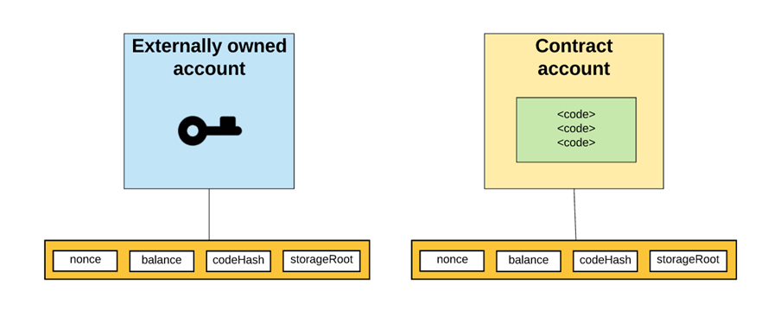

Slide 82
Accounts
External Account (EOA, Valid Ethereum Address)
Has an associated nonce (amount of transactions sent from the account) and a balance
codeHash - Hash of associated account code, i.e. a computer program for a smart contract (hash of an empty string for external accounts, EOAs)
Storage Root is root hash of Merkle-Patricia trie of associated account data

Slide 83
Accounts
Contract Account
Ethereum accounts can store and execute code
Has an associated nonce and balance
codeHash - hash of associated account code
storageRoot contains Merkle tree of associated storage data

Slide 84
Block
Blocks are the main building blocks of a blockchain.
Ethereum blocks consist of various components
Block header
Transactions list
List of headers of Ommers or Uncles
Transaction list is simply a list of all transactions included in the block.
In addition, List of headers of Uncles is also included in the block.
The most important and complex part is the block header

Slide 85
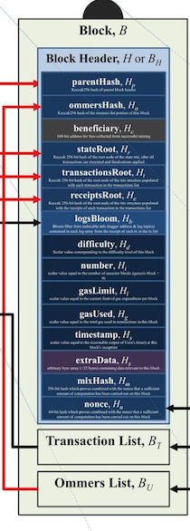
Ethereum Block
Blocks consist of 3 elements
Transaction List
List of all transactions included in a block
Block Header
Group of 15 elements
Ommer List
List of all Uncle blocks included

Slide 86
Uncles/Ommers
Sometimes valid block solutions don’t make main chain
Any broadcast block (up to 6 previous blocks back) with valid PoW and difficulty can be included as an uncle
Maximum of two can be included per block
Uncle block transactions are not included just header are included
Aimed to decrease centralization and reward work

Slide 87
Uncles/Ommers Rewards:
Uncle headers can be included in main block for 1/32 of the main block miner’s reward given to said miner
Miners of uncle blocks receive percent of main reward according to:
(U_{n} + (8 - B_{n})) * 5 / 8, where U_{n} and B_{n} are uncle and block numbers respectively.
Example (1333 + 8 - 1335) * ⅝ = 3.75 ETH

Slide 88
Block header
Block headers are the most critical and detailed components of an Ethereum block.
The header contains valuable information
Parent hash
This is the Keccak 256-bit hash of the parent (previous) block's header.
Ommers hash
This is the Keccak 256-bit hash of the list of Ommers (Uncles) blocks included in the block.
Beneficiary
Beneficiary field contains the 160-bit address of the recipient that will receive the mining reward once the block is successfully mined.

Slide 89
Block header
State root
The state root field contains the Keccak 256-bit hash of the root node of the state trie.
It is calculated after all transactions have been processed and finalized.
Transactions root
The transaction root is the Keccak 256-bit hash of the root node of the transaction trie.
Transaction trie represents the list of transactions included in the block.
Receipts root
The receipts root is the keccak 256 bit hash of the root node of the transaction receipt trie.
This trie is composed of receipts of all transactions included in the block.
Transaction receipts are generated after each transaction is processed and contain useful posttransaction information.

Slide 90
Block header
Logs bloom
The logs bloom is a bloom filter that is composed of the logger address and log topics from the log entry of each transaction receipt of the included transaction list in the block.
Difficulty
The difficulty level of the current block.
Number
The total number of all previous blocks; the genesis block is block zero.
Gas limit
The field contains the value that represents the limit set on the gas consumption per block.

Slide 91
Block header
Gas used
The field contains the total gas consumed by the transactions included in the block.
Timestamp
Timestamp is the epoch Unix time of the time of block initialization.
Extra data
Extra data field can be used to store arbitrary data related to the block.

Slide 92
Block header
Mixhash
Mixhash field contains a 256-bit hash that once combined with the nonce is used to prove that adequate computational effort has been spent in order to create this block.
Nonce
Nonce is a 64-bit hash (a number) that is used to prove, in combination with the mixhash field, that adequate computational effort has been spent in order to create this block.

Slide 93
Extra Points
World state: the hard drive of the distributed computer that is Ethereum. It is a mapping between addresses and account states.
Account state: stores the state of each one of Ethereum’s accounts. It also contains the storageRoot of the account state trie, that contains the storage data for the account.
Transaction: represents a state transition in the system. It can be a funds transfer, a message call or a contract deployment.

Slide 94
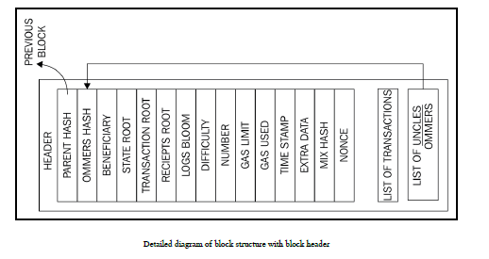

Slide 95
Example

Slide 97
Transaction receipts
Transaction receipts are used as a mechanism to store the state after a transaction has been executed.
These structures are used to record the outcome of the transaction execution.
It is produced after the execution of each transaction.
All receipts are stored in an index-keyed trie. Hash (Keccak 256-bit) of the root of this trie is placed in the block header as the receipts root.
It is composed of four elements

Slide 98
Transaction receipts- four elements
Post-transaction state
This item is a trie structure that holds the state after the transaction has executed.
It is encoded as a byte array.
Gas used
This item represents the total amount of gas used in the block that contains the transaction receipt.
The value is taken immediately after the transaction execution is completed.
The total gas used is expected to be a non-negative integer.
Set of logs
This field shows the set of log entries created as a result of transaction execution.
Log entries contain the logger's address, a series of log topics, and the log data.

Slide 99
Transaction receipts- four elements
The bloom filter
Bloom filter is created from the information contained in the set of logs
A log entry is reduced to a hash of 256 bytes, which is then embedded in the header of the block as the logs bloom.
Log entry is composed of the logger's address and log topics and log data.
Log topics are encoded as a series of 32 byte data structures.
Log data is made up of a few bytes of data.

Slide 100
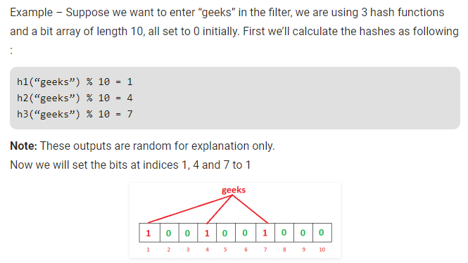
Bloom Filter
Bloom filter is a space-efficient probabilistic data structure that is used to test whether an element is a member of a set.
For example, checking availability of username is set membership problem, where the set is the list of all registered username.

Slide 102
Transaction validation and execution
Transactions are executed after verifying the transactions for validity.
Initial tests are
Transaction must be well-formed and RLP-encoded without any additional trailing bytes
Digital signature used to sign the transaction is valid
Transaction nonce must be equal to the sender's account's current nonce
Gas limit must not be less than the gas used by the transaction
Sender's account contains enough balance to cover the execution cost

Slide 103
Why RLP (Recursive Length Prefix) is used by Etherum?
RLP (Recursive Length Prefix) is to encode arbitrarily nested arrays of binary data, and RLP is the main encoding method used to serialize objects in Ethereum.
RLP is intended to be a highly minimalistic serialization format, its purpose is to store nested arrays of bytes.
It only encodes the structure of the data which it encodes, it doesn't know anything about what kind of object it was before you encoded it.
This reduces the overall size of the encoding but does require the decoder of the bytes to know what kind of object it is looking for.

Slide 104
Transaction sub state
Transaction sub-state is created during the execution of the transaction that is processed immediately after the execution completes.
Transaction sub-state is a tuple that is composed of three items
Suicide set
This element contains the list of accounts that are disposed of after the transaction is executed.
Log series
This is an indexed series of checkpoints that allow the monitoring and notification of contract calls to the entities external to the Ethereum environment
It works like a trigger mechanism that is executed every time a specific function is invoked or a specific event occurs.
Logs are created in response to events occurring in the smart contract.

Slide 105
Refund balance
This is the total price of gas in the transaction that initiated the execution.
Refunds are not immediately executed; instead, they are used to partially offset the total execution cost.

Slide 106
The block validation mechanism
Ethereum block is considered valid if it passes the following checks:
Consistent with Uncles and transactions.
This means that all Ommers (Uncles) satisfy the property that they are indeed Uncles and also if the Proof of Work for Uncles is valid.
If the previous block (parent) exists and is valid.
If the timestamp of the block is valid.
current block's timestamp must be higher than the parent block's timestamp.
It should be less than 15 minutes into the future.
All block times are calculated in epoch time
If any of these checks fails, the block will be rejected

Slide 107
Block finalization
Block finalization is a process that is run by miners in order to validate the contents of the block and apply rewards.
It results in four steps being executed
Ommers validation
Validate Ommers (stale blocks also called Uncles).
In case of Miner, Determine Ommers.
Validation process of the headers of stale blocks checks whether the header is valid and the relationship of the Uncle with the current block satisfies the maximum depth of six blocks.
A block can contain a maximum of two Uncles.
State and nonce validation
Verify the state and nonce.
In the case of mining, compute a valid state and nonce.

Slide 108
Block finalization
Transaction validation
Validate transactions.
In the case of mining, determine transactions.
Checking whether the total gas used in the block is equal to the final gas consumption after the final transaction.
Reward application
Apply rewards, which means updating the beneficiary's account with a reward balance.
In Ethereum, a reward is also given to miners for stale blocks, which is 1/32 of the block reward.
Uncles that are included in the blocks also receive 7/8 of the total block reward.
The current block reward is 5 Ether. A block can have a maximum of two Uncles.

Slide 109
Block difficulty
Block difficulty is increased if the time between two blocks decreases,
This is required to maintain a roughly consistent block generation time.
The difficulty adjustment algorithm in Ethereum's homestead release is shown as follows:

Slide 110
Block difficulty
The preceding algorithm means that, if the time difference between the generation of the parent block and the current block is less than 10 seconds, the difficulty goes up.
If the time difference is between 10 to 19 seconds, the difficulty level remains the same.
Finally, if the time difference is 20 seconds or more, the difficultly level decreases.
This decrease is proportional to the time difference.

Slide 111
Block difficulty
In addition to timestamp-difference-based difficulty adjustment, there is also another part (last line of the algorithm) that increases the difficulty exponentially after every 100,000 blocks.
This is the so called difficulty time bomb or Ice age introduced in the Ethereum network, which will make it very hard to mine
This will encourage users to switch to Proof of Stake as mining on the POW chain will eventually become prohibitively difficult.
Block generation time will become significantly high during the second half of the year 2017 and in 2021, it will become so high that it will be virtually impossible to mine on the POW chain.
Miners will have no choice but to switch to the Proof of Stake scheme proposed by Ethereum called Casper.

Slide 112
Below is step by step process how difficulty of new block gets created.
1. First, difference between time of formation of parent block and new block is calculated.
2. Output of step 1 is then divided by 10 and integer of it is stored. This is done to create ranges. If output of step 1 is between 1 – 9 then output of this step will be 0. If output of step 1 is between 10 – 19 then output of this step will be 1. If output of step 1 is between 20 – 29 then output of this step will be 2 and so on.
3. From step above various ranges gets created. Now in order to create three ranges we will subtract 1 from output of step 2. The three ranges will be either +ve, zero or –ve. If you see it carefully then output of this step will be +ve when output of step 1 is between 0 – 9, zero when output of step 1 is between 10 – 19 and –ve when output of step 1 is anything more than 20.

Slide 113
4. Now compare output of previous step with -99 and if it is even lesser than -99 then set it as -99. This is done to limit the smallest possible value of step 3, otherwise keep the value of output of previous step as is.
5. Next we divide the parent block difficulty by the difficulty bound divisor, whose value is 2048.
6. Multiply output of step 4 with step 5. This will give the difference of difficulty of new block with old parent block. Depending is this value is +ve then difficulty will increase and if this value is –ve then then new difficulty will decrease.
7. Now add output of step 6 to parent difficulty and result will be the difficulty of the new block.
8. Once difficulty is calculated, a check is made to make sure that difficulty calculated is at least more than the minimum threshold value of 131072.

Slide 114
9. Before returning the difficulty, check is done that if block number is more than 200,000 then “The Bomb” logic is applied to increase the difficulty exponentially.
10. In order to increase the difficulty exponentially, new block number is calculated by adding one to the parent block number.
11. Now new block number is divided by 100,000.
12. If new block number is more than 200,000 then output of step 11 is subtracted from 2.
13. Now exponentially increased difficulty delta is calculated by doing following calculation: 2 ^ output of step 12.
14. And new difficulty is calculated by adding output of previous step to the difficulty calculated in step 7.

Slide 115
Ether
Ether is minted by miners as a currency reward for the computational effort
spent in order to secure the network by verifying and with validation transactions and blocks.
Ether is used within the Ethereum blockchain to pay for the execution of contracts on the EVM.
Ether is used to purchase gas as crypto fuel, which is required in order to perform computation on the Ethereum blockchain.
Fees are charged for each computation performed by the EVM on the blockchain

Slide 117
Gas
Gas is required to be paid for every operation performed on the ethereum blockchain.
mechanism to ensures that infinite loops cannot cause the whole blockchain to stall due to the Turing-complete nature of the EVM.
Transaction fee is charged as some amount of Ether and is taken from the account balance of the transaction originator.
A fee is paid for transactions to be included by miners for mining.
If this fee is too low, the transaction may never be picked up; the more the fee, the higher the chances that the transactions will be picked up by the miners for inclusion in the block.
If the transaction that has an appropriate fee paid is included in the block by miners but has too many complex operations to perform,
it can result in an out-of-gas exception if the gas cost is not enough.
In this case, the transaction will fail but will still be made part of the block and the transaction originator will not get any refund.

Slide 118
Transaction cost can be estimated using the following formula:
Total cost = gasUsed * gasPrice
gasUsed is the total gas that is supposed to be used by the transaction during the execution
gasPrice is specified by the transaction originator as an incentive to the miners to include the transaction in the next block. This is specified in Ether.
Each EVM opcode has a fee assigned to it.
It is an estimate because the gas used can be more or less than the value specified by the transaction originator originally.
For example, if computation takes too long or the behavior of the smart contract changes in response to some other factors, then the transaction execution may perform more or less operations than originally intended and can result in consuming more or fewer gas.
if the execution is successful and there is some remaining gas, then it is returned to the transaction originator.

Slide 119
Example
calculation of the SHA3 operation can be calculated as follows:
SHA3 costs 30 gas
Current gas price is 25 GWei, which is 0.000000025 Ether
Multiplying both: 0.000000025 * 30 = 0.00000075 Ether

Slide 120
Fee schedule
Gas is charged in three scenarios as a prerequisite to the execution of an operation:
The computation of an operation
For contract creation or message call
Increase in the usage of memory

Slide 121
Messages
Messages are the data and value that are passed between two accounts.
Message is a data packet passed between two accounts.
This data packet contains data and value (amount of ether).
It can either be sent via a smart contract (autonomous object) or from an external actor (externally owned account) in the form of a transaction that has been digitally signed by the sender.
Contracts can send messages to other contracts.
Messages only exist in the execution environment and are never stored.
Messages are similar to transactions;
Messages are produced by the contracts,
transactions are produced by entities external (externally owned accounts)

Slide 122
Messages
A message consists of the components mentioned here:
Sender of the message
Recipient of the message
Amount of Wei to transfer and message to the contract address
Optional data field (Input data for the contract)
Maximum amount of gas that can be consumed
Messages are generated when CALL or DELEGATECALL Opcodes are executed by the contracts.

Slide 123
Calls
A call does not broadcast anything to the blockchain; instead, it is a local call to a contract function and runs locally on the node.
It is almost like a local function call.
It does not consume any gas as it is a read-only operation.
Calls are executed locally on a node and generally do not result in any state change.
this is the act of passing a message from one account to another.
If the destination account has an associated EVM code, then the virtual machine will start upon the receipt of the message to perform the required operations.
If the message sender is an autonomous object, then the call passes any data returned from the virtual machine operation.
State is altered by transactions.

Slide 124
Mining
Mining is the process by which new currency is added to the blockchain.
Incentive for the miners to validate and verify blocks made up of transactions.
Mining process helps secure the network by verifying computations.

Slide 125
Mining
At a theoretical level, a miner performs the following functions:
Listens for the transactions broadcasted on the Ethereum network and determines the transactions to be processed.
Determines stale blocks called Uncles or Ommers and includes them in the block.
Updates the account balance with the reward earned from successfully mining the block.
Finally, a valid state is computed and block is finalized, which defines the result of all state transitions.

Slide 126
Mining
The current method of mining is based on Proof of Work, which is similar to that of bitcoin.
When a block is deemed valid, it has to satisfy not only the general consistency requirements, but it must also contain the Proof of Work for a given difficulty.
The Proof of Work algorithm is due to be replaced with the Proof of Stake algorithm with the release of serenity.
An Algorithm named Casper has been developed, which will replace the existing Proof of Work algorithm in Ethereum.
This is a security deposit based on the economic protocol where nodes are required to place a security deposit before they can produce blocks.
Nodes have been named bonded validators in Casper, whereas the act of placing the security deposit is named bonding.

Slide 127
Ethash
Ethash is the name of the Proof of Work algorithm used in Ethereum.
Originally, this was proposed as the Dagger-Hashimoto algorithm
Core idea behind mining is to find a nonce that once hashed the result in a predetermined difficulty level.
Initially, the difficulty was low when Ethereum was new and even CPU and single GPU mining was profitable to a certain extent, but that is no longer the case.
Ethash is a memory-hard algorithm, which makes it difficult to be implemented on specialized hardware

Slide 128
Ethash
As in bitcoin, ASICs have been developed, which have resulted in mining centralization over the years
But memory-hard Proof of Work algorithms are one way of thwarting this threat
Ethereum implements Ethash to discourage ASIC development for mining.
This algorithm requires choosing subsets of a fixed resource called DAG (Directed Acyclic Graph) depending on the nonce and block headers.
DAG is around 2 GB in size and changes every 30000 blocks.
Mining can only start when DAG is completely generated the first time a mining node starts.
The time between every 30000 blocks is around 5.2 days and is called epoch.
This DAG is used as a seed by the Proof of Work algorithm called Ethash.

Slide 129
Ethash
Current reward scheme is 5 Ether for successfully finding a valid nonce.
In addition to receiving 5 Ethers, the successful miner also receives the cost of the gas consumed within the block and an additional reward for including stale blocks (Uncles) in the block.
A maximum of two Uncles are allowed per block and are rewarded 7/8 of the normal block reward.
In order to achieve a 12 second block time, block difficulty is adjusted at every block.
The rewards are directly proportional to the miner's hash rate, which basically means how fast a miner can hash.
Mining can be performed by simply joining the Ethereum network and running an appropriate client.
The key requirement is that the node should be fully synced with the main network before mining can start.

Slide 130
CPU mining
CPU mining is still valuable on the test network or even a private network to experiment with mining and contract deployment.
Geth can be started with mine switch in order to start mining:
geth --mine --minerthreads <n>
CPU mining can also be started using the web 3 geth console.
Geth console can be started by issuing the following command:
geth attach
After this, the miner can be started by issuing the following command, which will return true if successful, or false otherwise
Miner.start(4)
True
The preceding command will start the miner with four threads.
Miner.stop
True
The preceding command will stop the miner. The command will return true if successful

Slide 131
GPU mining
At a basic level, GPU mining can be performed easily by running two commands:
geth –rpc
Once geth is up and running and the blockchain is fully downloaded
Ethminer can be run in order to start mining.
Ethminer is a standalone miner that can also be used in the farm mode to contribute to mining pools.
It can be downloaded from h t t p s ://g i t h u b . c o m /G e n oi l /c p p - e t h e r e u m /t r e e /m a s t e r /r e l e a s e s :
Ethminer -G

Slide 132
GPU mining
GPU mining requires an AMD or Nvidia graphics card and an applicable OpenCL SDK.
For NVidia chipset, it can downloaded from h t t p s ://d e v e l o p e r . n v i d i a . c o m /c u d a - d o w n l o a ds .
For AMD chipsets, it is available at h t t p ://d e v e l o p e r . a m d . c o m /t o o l s - a n d - s d k s /o p e n cl - z o n e /a m d - a c c e l e r a t e d - p a r a l l e l - p r o c e s s i n g - a p p - s d k .
CPU benchmarking
$ ethminer -M -C
GPU benchmarking
$ ethminer -M -G

Slide 133
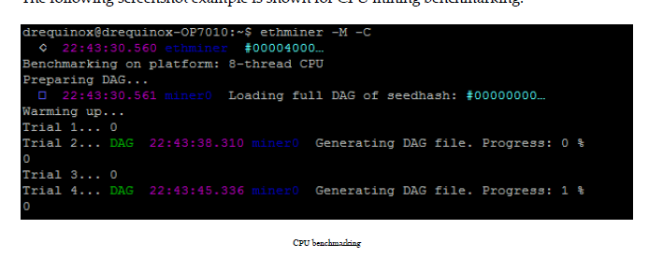

Slide 134
GPU mining
GPU device to be used can also be specified in the command line:
$ ethminer -M -G --opencl-device 1
As GPU mining is implemented using OpenCL AMD, chipset-based GPUs tend to work faster as compared to NVidia GPUs.
Due to the high memory requirements (DAG creation), FPGAs and ASICs will not provide any major advantage over GPUs.
In order to discourage the development of specialized hardware for mining.

Slide 135
Mining rigs
As difficulty increased over time for mining Ether,
Mining rigs with multiple GPUs were starting to be built by the miners.
Mining rig usually contains around five GPU cards, and all of them work in parallel for mining
thus improving the chances of finding valid nonces for mining.
Mining rigs can be built with some effort and are also available commercially from various vendors.

Slide 136
Typical mining rig configuration
Motherboard
A specialized motherboard with multiple PCI-E x1 or x16 slots,
SSD hard drive
SSD drive is recommended because of its much faster performance over the analog equivalent.
This will be mainly used to store the blockchain
GPU
GPU is the most important component of the rig as it is the main workhorse that will be used for mining.
For example, it can be a Sapphire AMD Radeon R9 380 with 4 GB RAM.

Slide 137
Typical mining rig configuration
Linux Ubuntu's latest version is usually chosen as the operating system for the rig.
There is also another variant of Linux available, called EthOS
Mining software such as Ethminer and geth are installed.
Remote monitoring and administration software is also installed so that rigs can be monitored and managed remotely,
Air conditioning or cooling mechanisms in place as running multiple GPUs can generate a lot of heat

Slide 139
Mining pools
Online mining pools that offer Ethereum mining.
Ethminer can be used to connect to a mining pool using the following command.
ethminer -C –F http://ethereumpool.co/?miner=0.1@0x024a20cc5feba7f3dc3776075b3e60c20eb1459c@DrEquinox
Each pool publishes its own instructions, but generally, the process of connecting to a pool is similar.

Slide 140
Clients and wallets
Geth
This is the Go implementation of the Ethereum client.
Eth
This is the C++ implementation of the Ethereum client.
Pyethapp
This is the Python implementation of the Ethereum client.
Parity
This implementation is built using Rust and developed by EthCore.

Slide 141
Light clients
SPV clients download only a small subset of the blockchain.
This allows low resource devices, such as mobile phones, embedded devices, or tablets, to be able to verify the transactions.
SPV clients validate the execution of transactions.
SPV clients are also called light clients.
There is a wallet available from Jaxx (h t t p s ://j a x x . i o / ),
which can be installed on iOS and Android, which provides the SPV (Simple Payment Verification) functionality.

Slide 142
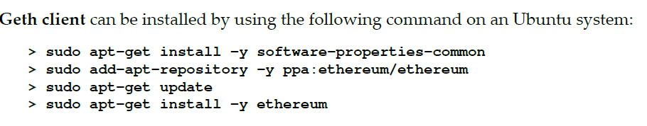
Installation
Geth can be launched simply by issuing the geth command at the command prompt
as it comes preconfigured with all the required parameters to connect to the live Ethereum network (mainnet):
> geth

Slide 143
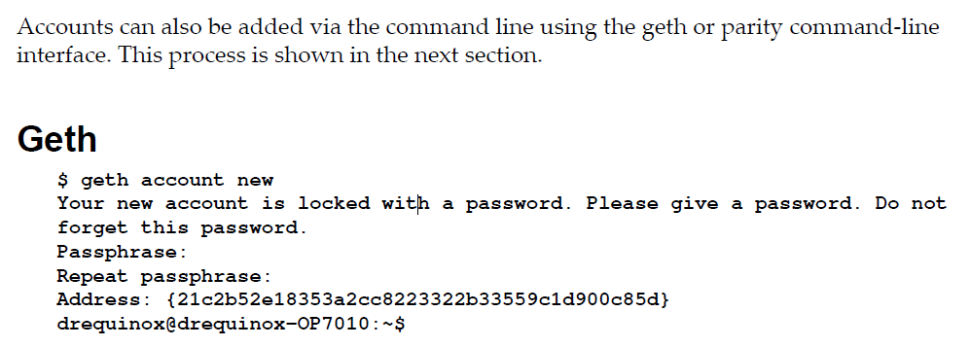
Installation

Slide 144
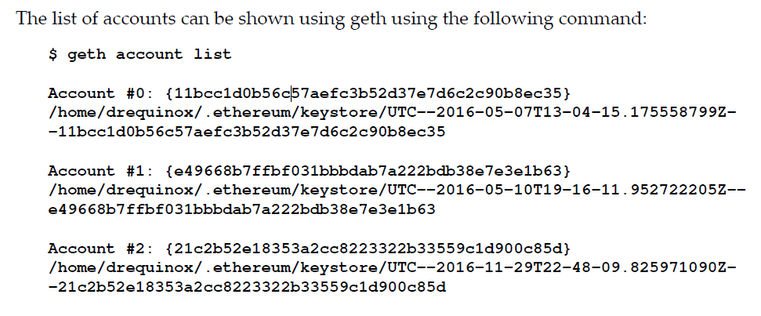

Slide 145
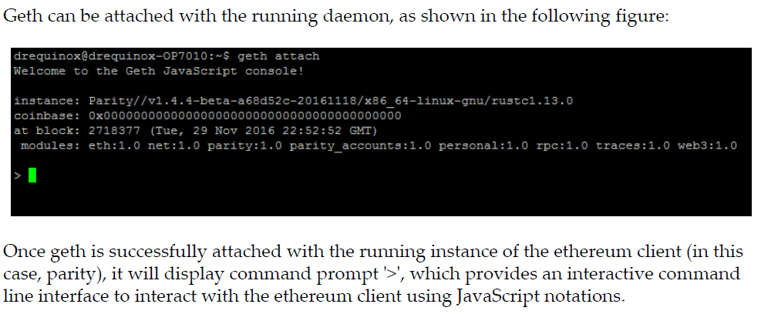
The geth console
The geth JavaScript console can be used to perform various functions

Slide 146
The yellow paper
The Ethereum yellow paper has been written by Dr. Gavin Wood
serves as a formal definition of the Ethereum protocol.
Anyone can implement an Ethereum client by following the protocol specifications defined in the paper.
Abstract
The blockchain paradigm when coupled with cryptographically-secured transactions has demonstrated its utility through a number of projects, with Bitcoin being one of the most notable ones. Each such project can be seen as a simple application on a decentralised, but singleton, compute resource. We can call this paradigm a transactional singleton machine with shared-state. Ethereum implements this paradigm in a generalised manner. Furthermore it provides a plurality of such resources, each with a distinct state and operating code but able to interact through a message-passing framework with others. We discuss its design, implementation issues, the opportunities it provides and the future hurdles we envisage.

Slide 147
Useful symbols

Slide 148
Useful symbols

Slide 149
Useful symbols

Slide 150
Useful symbols

Slide 151
The Ethereum network
The Ethereum network is a peer-to-peer network where nodes participate in order to maintain the blockchain and contribute to the consensus mechanism.
Networks can be divided into three types, based on requirements and usage.
MainNet
MainNet is the current live network of ethereum.
The current version of MainNet is homestead.
Latest release Muir Glacier / 1 January 2020

Slide 152
The Ethereum network
TestNet
TestNet is also called Ropsten and is the test network for the Ethereum blockchain.
This blockchain is used to test smart contracts and DApps before being deployed to the production live blockchain.
It allows experimentation and research.
Private net(s)
As the name suggests, this is the private network that can be created by generating a new genesis block.
This is usually the case in distributed ledger networks, where a private group of entities start their own blockchain and use it as a permissioned blockchain.

Slide 153
Supporting protocols
There are various supporting protocols that are in development in order to support the complete decentralized ecosystem.
whisper and Swarm protocols.
In addition to the contracts layer, which is the core blockchain layer, there are additional layers that need to be decentralized in order to achieve a complete decentralized ecosystem.
This includes decentralized storage and decentralized messaging.
Whisper, being developed for ethereum, is a decentralized messaging protocol,
Swarm is a decentralized storage protocol.

Slide 154
Whisper
Whisper provides decentralized peer-to-peer messaging capabilities to the Ethereum network.
whisper is a communication protocol that nodes use in order to communicate with each other.
The data and routing of messages are encrypted within whisper communications.
used for smaller data transfers and in scenarios where real-time communication is not required.
Whisper is also designed to provide a communication layer that cannot be traced and provides “dark communication” between parties.
Blockchain can be used for communication, but that is expensive and consensus is not really required for messages exchanged between nodes.
Therefore, whisper can be used as a protocol that allows
Whisper is already available with geth

Slide 155
Swarm
Swarm is being developed as a distributed file storage platform.
It is a decentralized, distributed, and peer-to-peer storage network.
Files in this network are addressed by the hash of their content.
This is in contrast to the traditional centralized services, where storage is available at a central location only.
This is developed as a native base layer service for the Ethereum web 3.0 stack.
Swarm is integrated with DevP2P, which is the multiprotocol network layer of Ethereum.
Swarm is envisaged to provide a DDOS (Distributed Denial of service)-resistant and fault-tolerant distributed storage layer for Ethereum Web 3.0.

Slide 156
High level overview of how Swarm and whisper

Slide 157
Applications developed on Ethereum
There are various implementations of DAOs and smart contracts in Ethereum,
DAO, which was recently hacked and required a hard fork in order for funds to be recovered.
DAO was created to serve as a decentralized platform to collect and distribute investments.
Augur is another DAPP that has been implemented on Ethereum, which is a decentralized prediction market

Slide 158
Scalability and security issues
Scalability in any blockchain is a fundamental issue.
co-founder Vitalik Buterin himself admitted. The network has a maximum capacity of 15 transactions per second, and he warned that if the status quo remains, the industry’s infrastructure will be unable to cope.
Although most people in the crypto world agree that frameworks and scalability need to be addressed, coming up with solutions takes time and a lot of effort.
In part, this is because any proposal has to have the support of miners, developers, businesses and other stakeholders before it can be enforced — a process which can take months and, even then, end in disagreement.
Security is also of paramount importance.
Issues such as privacy and confidentiality have caused some adaptability issues, especially in the financial sector.

Slide 159
References
Imran Bashir. “Mastring BlockChain”, Packt
Web Materials

